Slide 1

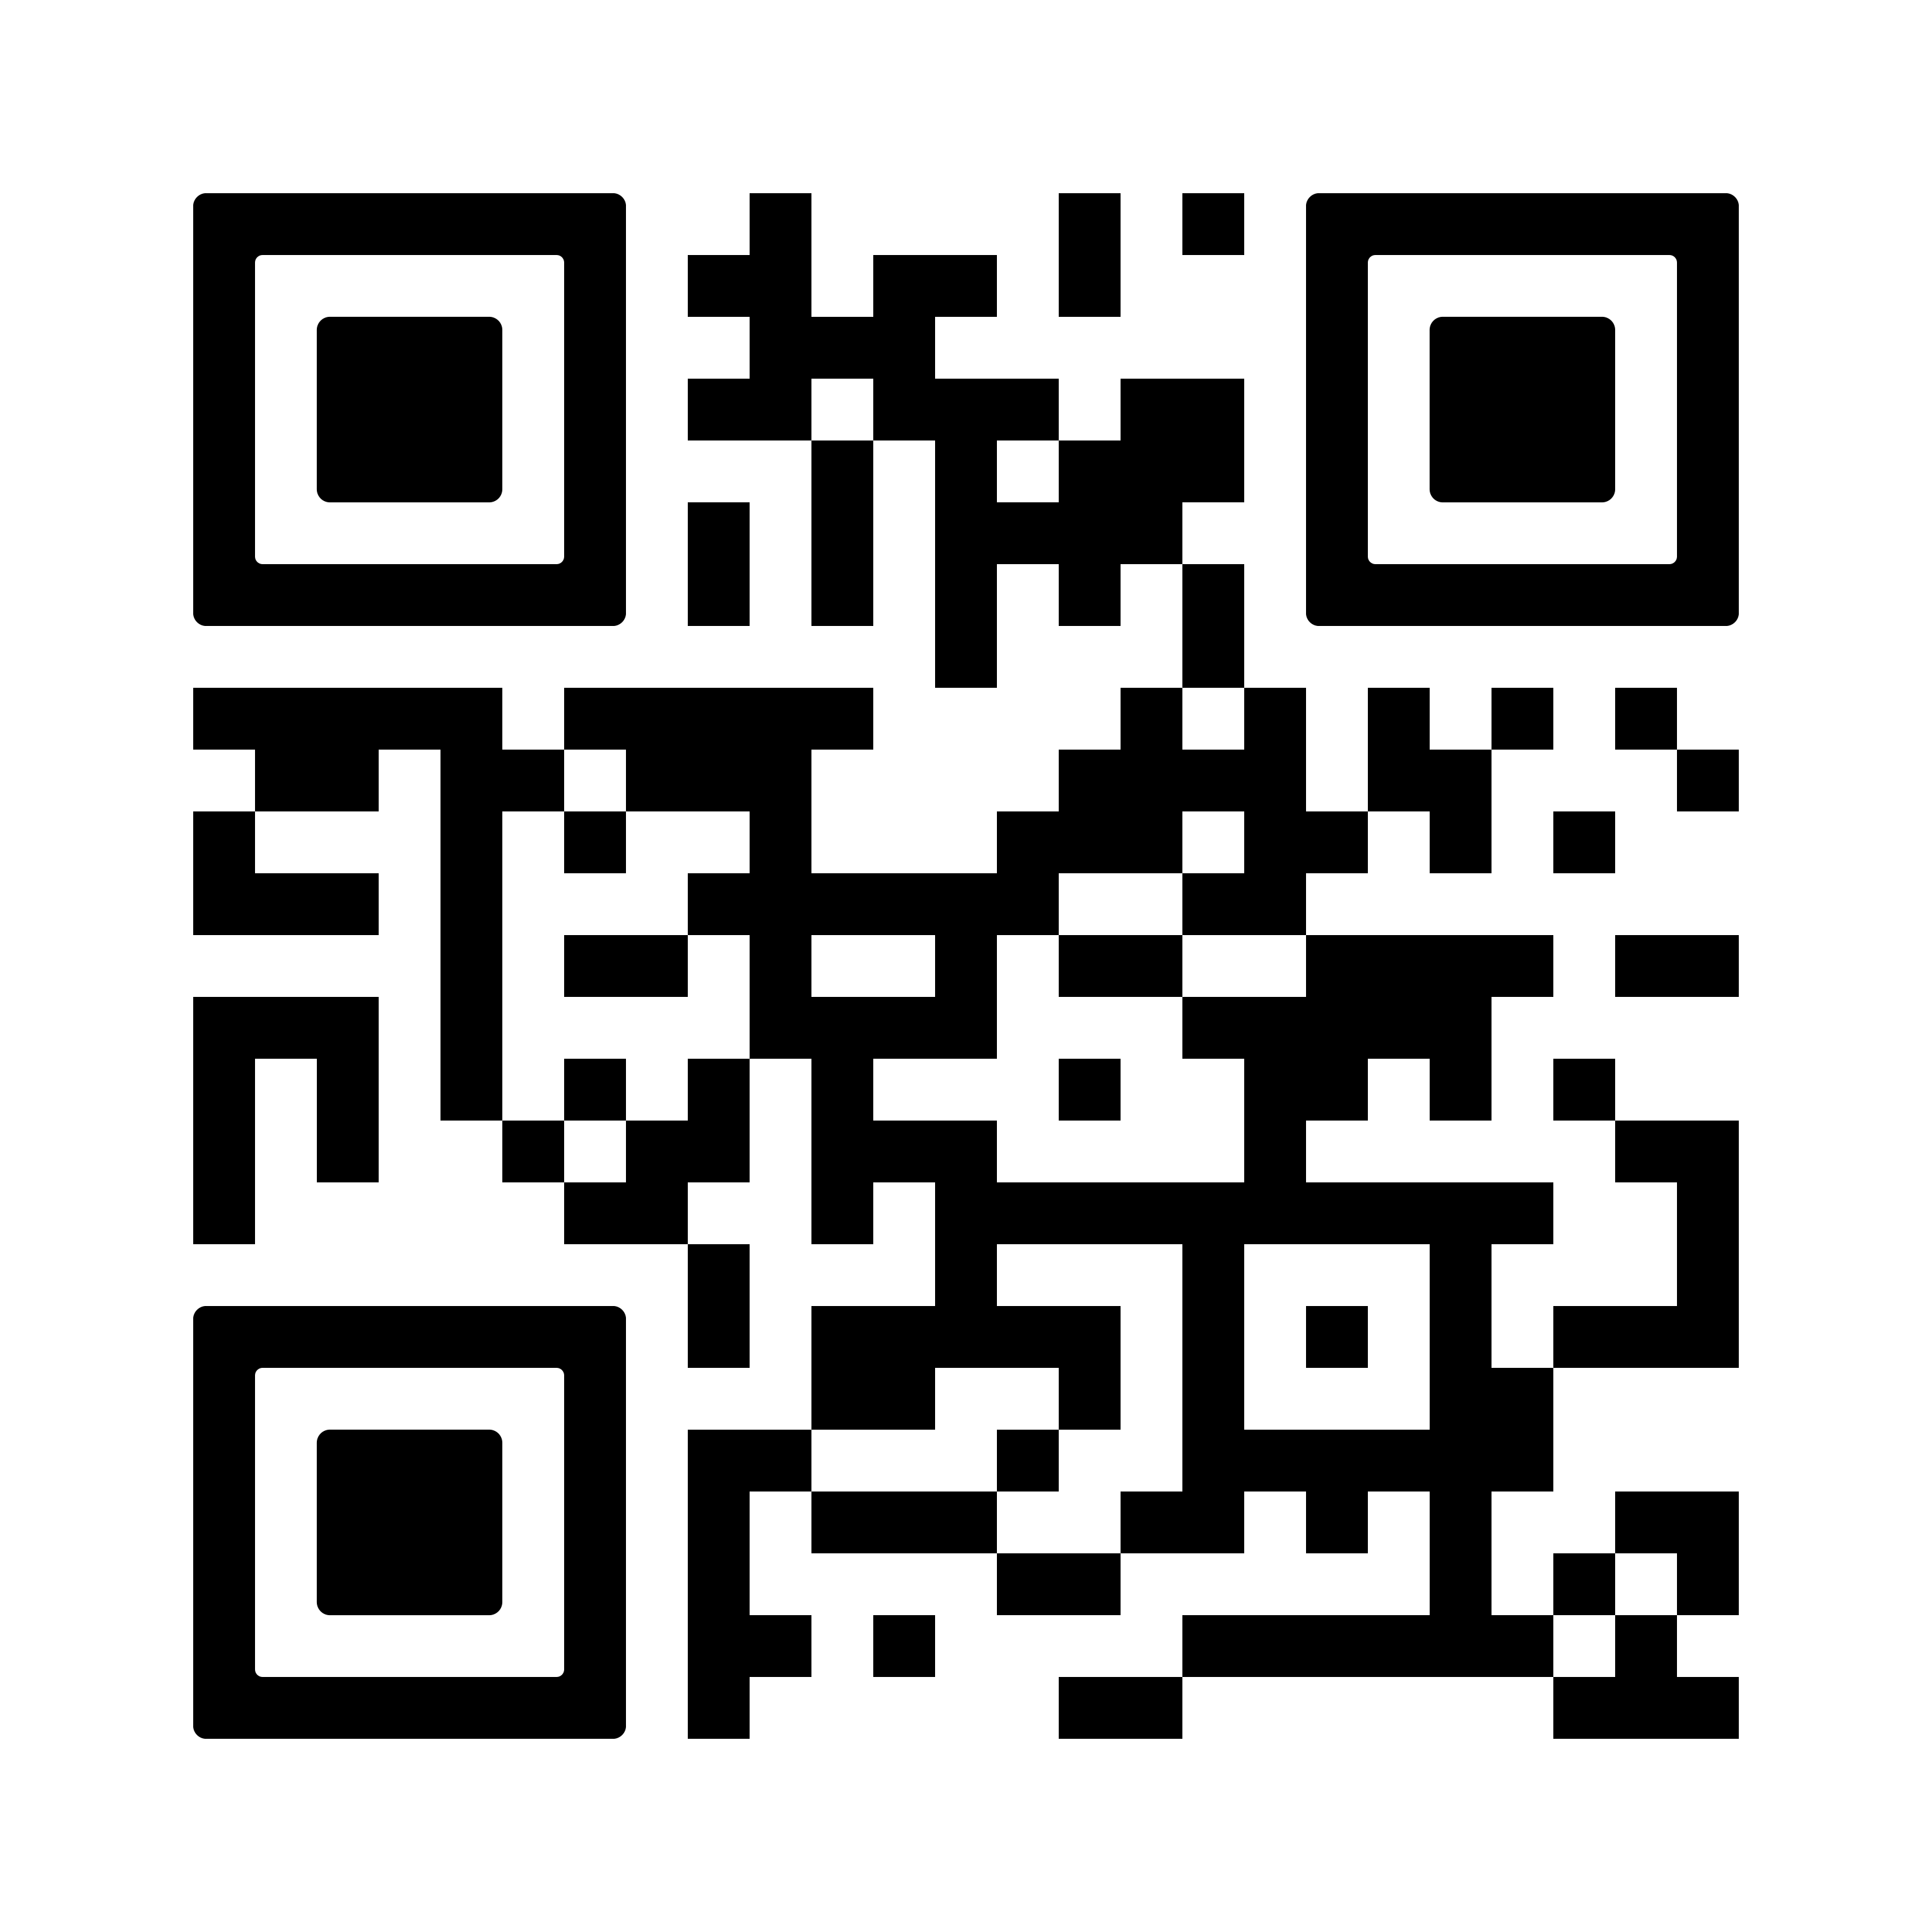
Food Support
Struggling to afford or access food? The Basic Needs Center can connect you to food resources, including CalFresh, California’s Supplemental Nutrition Assistance Program.
More students now qualify for CalFresh- scan the QR code to apply! Most students receive an average of $265 a month on a debit card to buy food, and benefits are accepted at many places on campus.
Application/recertification help: basicneeds.ucsd.edu
Instagram: @ucsdbasicneeds

